Slide 1
Tomato Grand Challenge
Basic Details of the Team and Problem Statement
Track | POC to Product Development Stage
Participant Category | Vertical 3
Vertical Title | Innovative post-harvest treatments, packaging and technologies for long term storage to minimize post- harvest losses during transportation and storage to avoid panic selling due to perishability.
Team Name | Electro Astroids
Team Leader Name | Vishwa S
No. of Team Members | 5
No. of Team Mentor | 2
For development of Comprehensive and focused intervention in design of tomato value chain

Slide 2
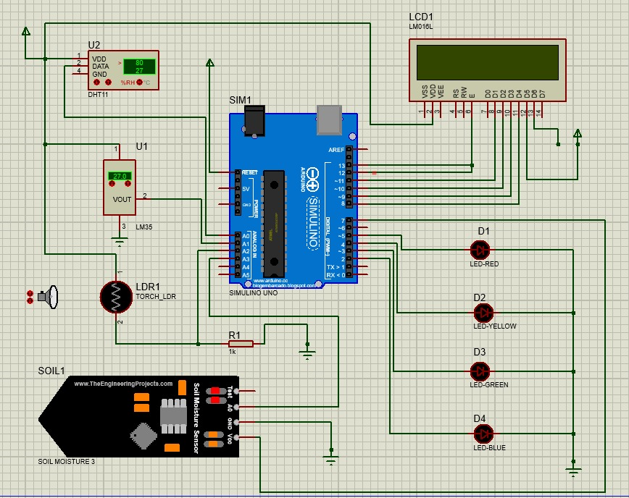
Idea / Approach Details
i) Evaporative Cooling System with galvanized steel and aluminum enhances tomato shelf life.
ii) Eco-friendly papaya cardboard packaging reduces losses, providing biodegradable, and moisture-resistant solutions.
Proteus Simulation:
Technology stack
CAD/CAE Software | SolidWorks
Programming | C++, Python
Manufacturing | Machining, fabrication, papaya cardboard production
Quality Control | Material and packaging testing
Environmental Test | Life cycle analysis
:
:
Impact | Reduced post-harvest losses, increased profitability, sustainable resource use, and environmental benefits.
Novelty | Compactable ECS design and innovative papaya-based packaging for transportation.

Slide 3
Idea / Approach Details
Use Cases
ECS for shelf life extension
Papaya packaging for transit freshness
ECS for cost-effective cooling
Papaya packaging for eco-friendliness
ECS and papaya for holistic solutions
Combined system for quality produce
Preservation for international standards
Solution for sustainable agriculture
Dependencies/ Resources
Market Research
Government Support
Marketing and Sales
Financial Resources
Transportation and logistics
Collabration with Farmers
Tomato Production
Papaya Raw Material

Slide 4
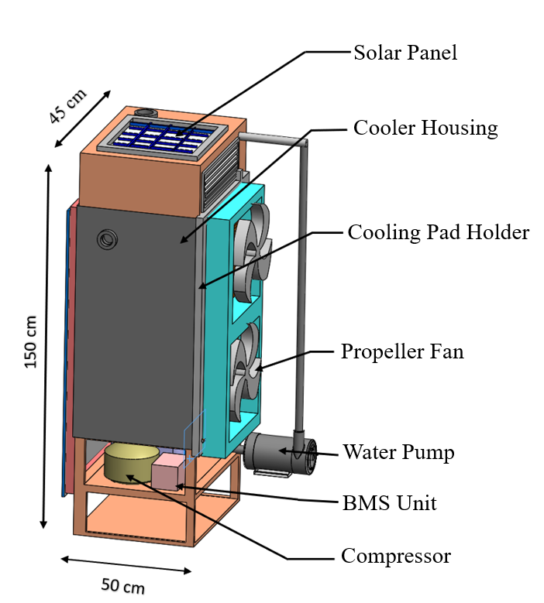
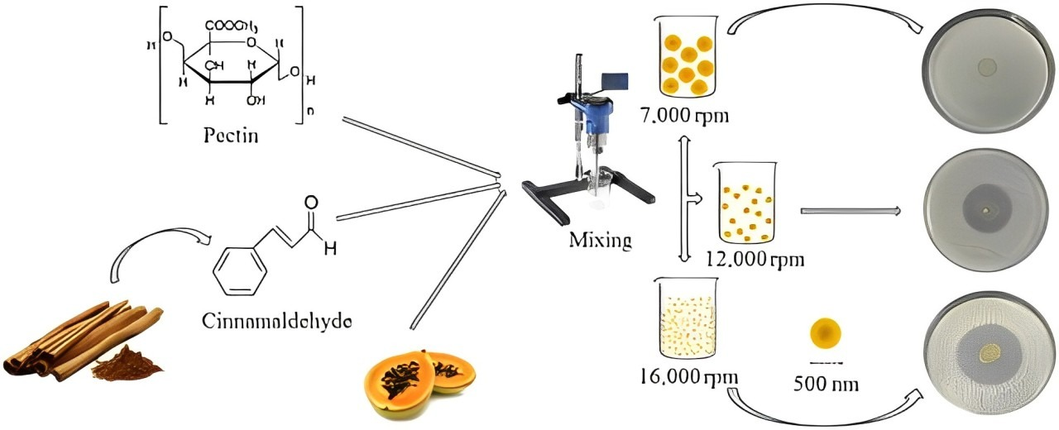
Proposal for Stage 1: Idea to Proof of Concept/ Prototype
- Papaya has high tensile strength of 20 - 30 MPa when hydroxypropyl methylcellulose is used as a binding agent.
- Tomato packaging materials with high methoxyl pectin binding agent exhibit 8.9 - 14.8 MPa of tensile strength
- Cancer cells are significantly reduced when pectin collected at different stages of papaya ripening are applied

Slide 5
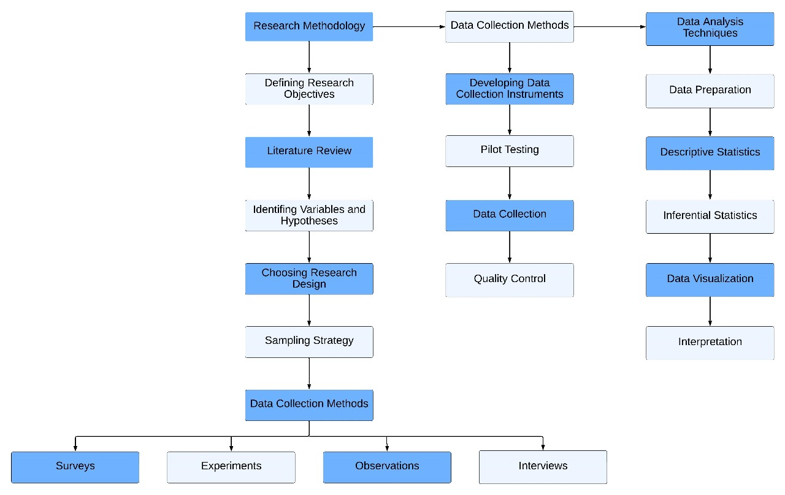
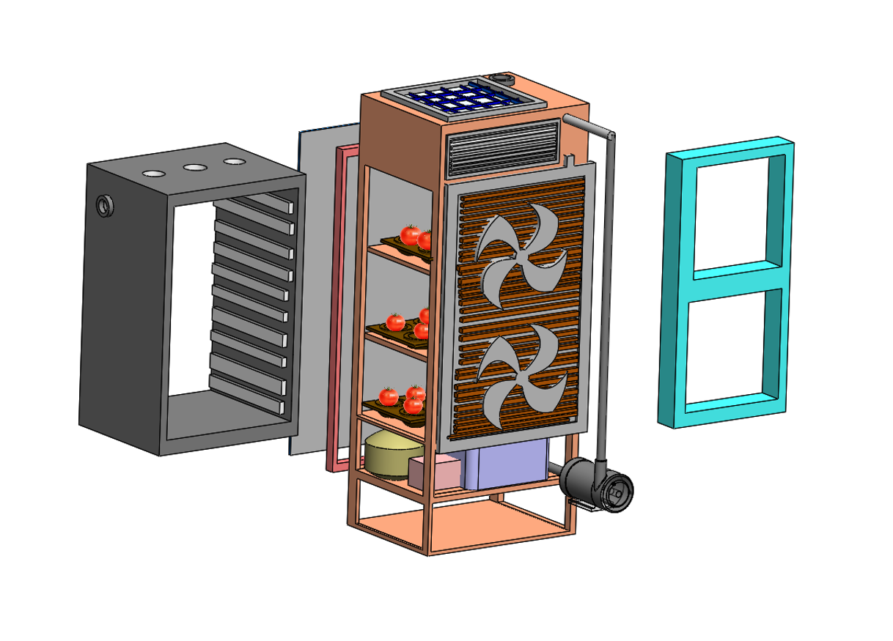
Data collection methods, and data analysis techniques, Research methodology, including research design

Slide 6
Objectives and Outputs
Month | 1st Month | 2nd Month | 3rd Month | 4th Month
Objective | Prototype Development | Material Sourcing and Testing | Papaya-Based Packaging Design | Regulatory Compliance Check
Outputs | Functional ECS Prototype | Material Compatibility Report | Papaya-Based Packaging Prototypes | Regulatory Approval Submission
Development cost
Material Costs | ₹30,000
Labor Costs | ₹25,000
Research and Development | ₹25,000
Regulatory Compliance | ₹10,000
Prototype Production | ₹50,000
Testing and Quality Assurance | ₹5,000
Market Research | ₹5,000
Marketing and Promotion | ₹5,000
IT Infrastructure | ₹10,000
Total | ₹1,65,000

Slide 7





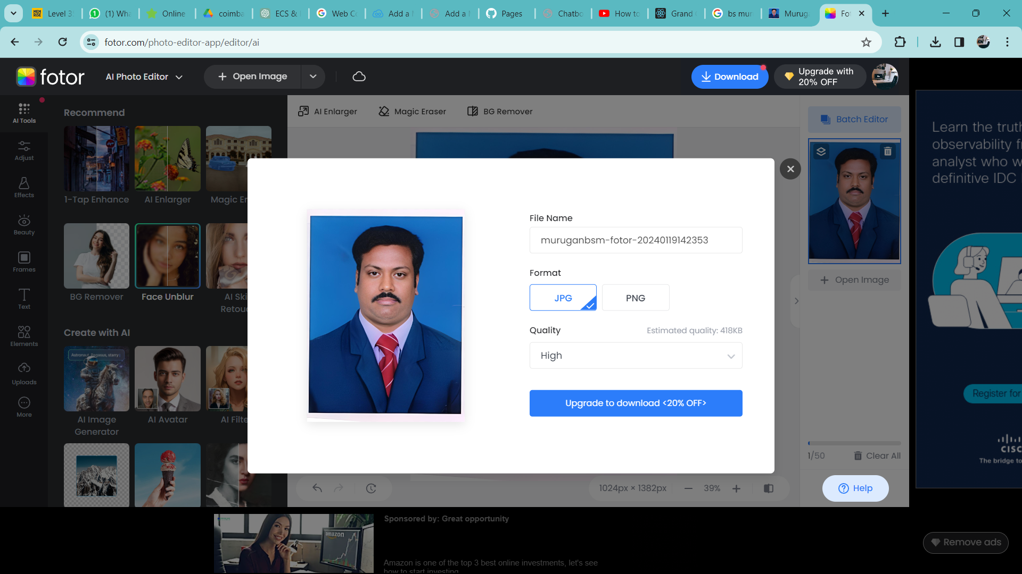

Team Member and Mentor Details (include name, email, contact no, photo)
Photo
Name | Vishwa S | Subash P | Pradeep V | Nikesh S | Sanjai B | B.S Murugan | Jeyakumar P
Email | vishwa05054@gmail.com | subashsivamani9595@gmail.com | velpradeep.vp1@gmail.com | nikeshs3996@gmail.com | sanjaibalakrishnan15@gmail.com | principal@mkce.ac.in | jeyakumarp.ece@mkce.ac.in
Contact no | 9345190256 | 9943249594 | 9790366017 | 9360507224 | 9025422429 | 9865230477 | 9994723025

